Slide 1



Evasive PDF Sample
Gonçalo Costa, up202103336
João Correia, up202005015
Ricardo Vieira, up202005091

Slide 2
The chosen dataset is a collection of evasive PDF samples, labeled as malicious (1) or benign (0). Since the dataset has an evasive nature, it can be used to test the robustness of trained PDF malware classifiers against evasion attacks. The dataset contains 500,000 generated evasive samples, including 450,000 malicious and 50,000 benign PDFs. This resource aims to support researchers and cybersecurity professionals in developing more advanced and robust detection mechanisms for PDF-based malware. It’s now our job to use this dataset to do exactly that: create a detection mechanism for PDF-based malware.
PROBLEM DEFINITION

Slide 3
Trad, F.; Hussein, A.; Chehab, A. Leveraging Adversarial Samples for Enhanced Classification of Malicious and Evasive PDF Files. Appl. Sci. 2023, 13, 3472. https://doi.org/10.3390/app13063472
https://www.kaggle.com/datasets/fouadtrad2/evasive-pdf-samples
Maryam Issakhani, Princy Victor, Ali Tekeoglu, and Arash Habibi Lashkari1, “PDF Malware Detection Based on Stacking Learning”, The International Conference on Information Systems Security and Privacy, February 2022
https://www.unb.ca/cic/datasets/pdfmal-2022.html
Related Work and references

Slide 4



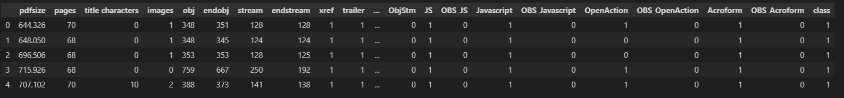
Development Environment
Programming Language
Data analysis
Algorithms to be used
Neural networks as they offer the capability to capture complex patterns, SVMs because they provide robustness in high-dimensional feature spaces and finally decision trees as they offer interpretability, albeit at the cost of potential limitations in handling complexity.
Dataframes
TOOLS AND ALGORITHMS

Slide 5
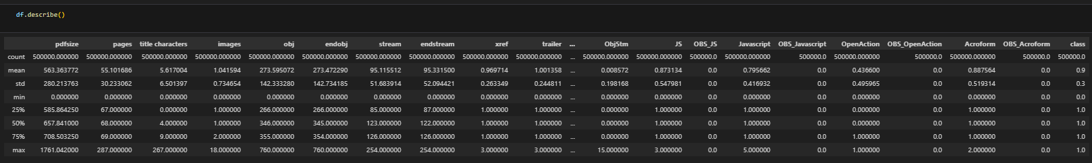
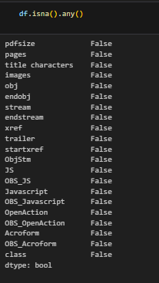
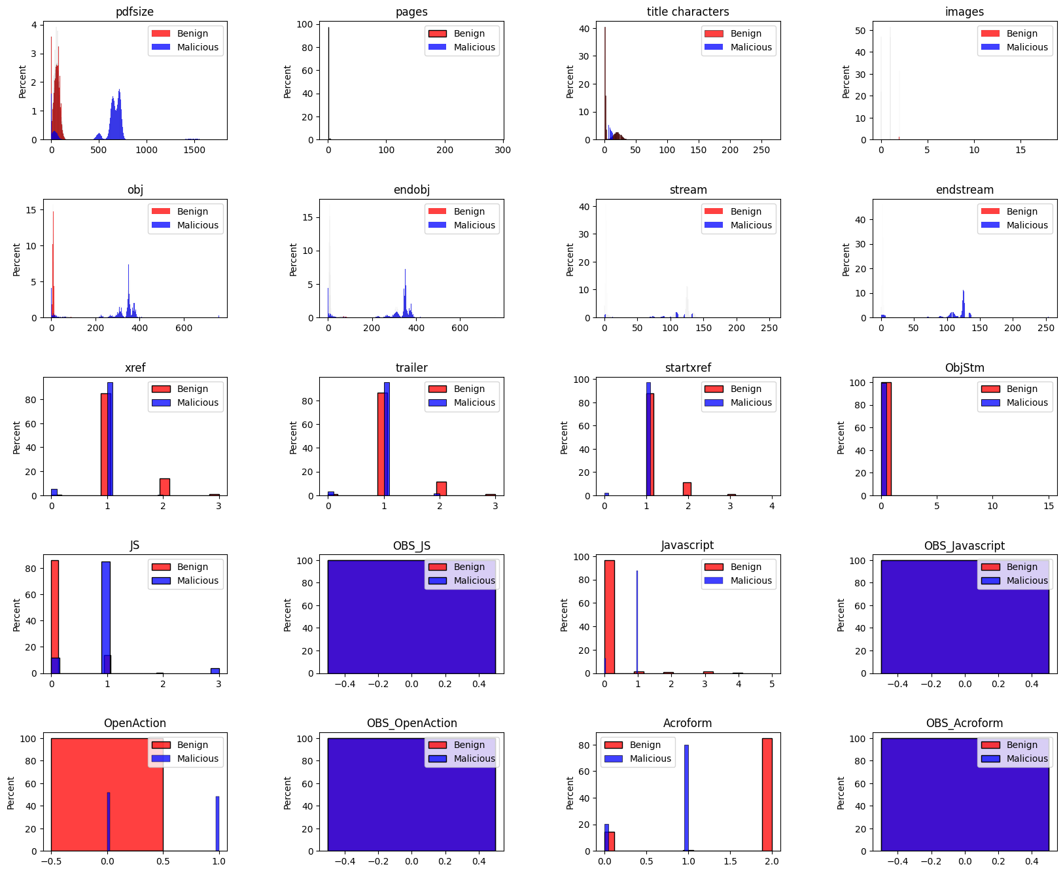
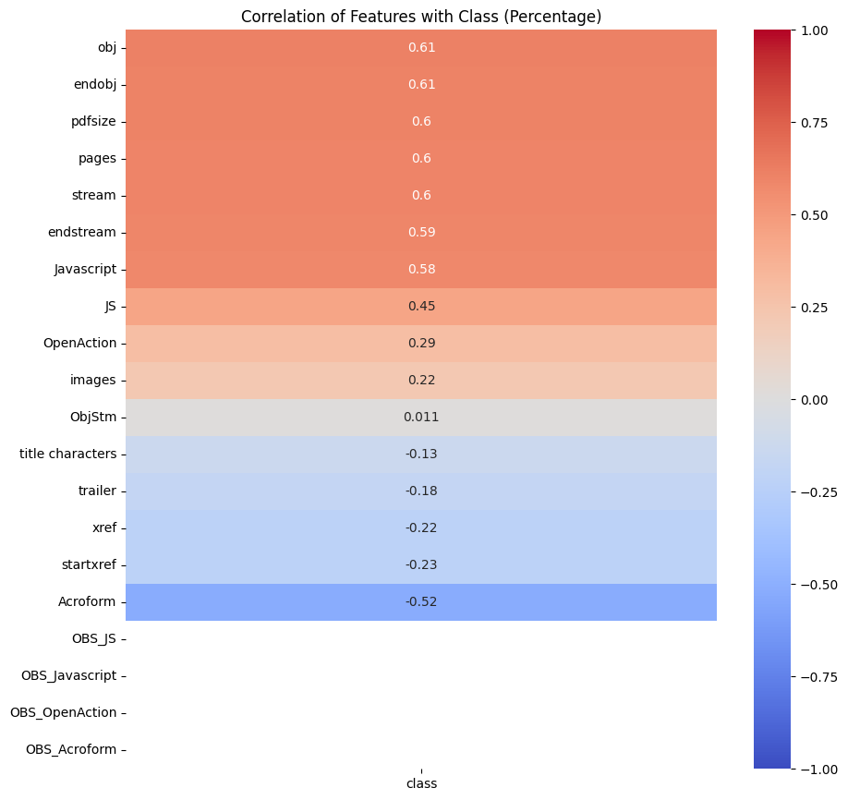
What we have done so far

